Slide 1
A Distributed and Autonomous Guard System Based on Cloud Environments
口試學生: 廖偉發
指導教授: 孫宏民 博士
Notes:
碩論題目：基於雲端環境下之分散式且自主的安全防衛系統

Slide 2
Outline
Motivation
Background & Related Work
Attack Model
Design Architecture & Implementation
Analysis
Conclusion

Slide 3
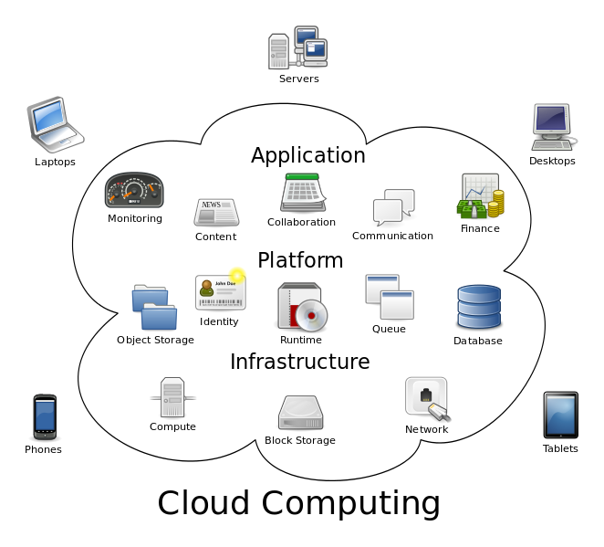
Motivation
Cloud computing has become a hot topic.
Cloud services face different security threats:
Data Breaches
Data Loss
Account Hijacking
Insecure APIs
Denial of Service
Malicious Insiders
Abuse of Cloud Services
Insufficient Due Diligence
Shared Technology Issues
Ref: Cloud Security Alliance research , 2013
Notes:
雲端運算在近年來已經是一個非常熱門的話題，
不管是在IT界或是一般日常生活中，我們都可以發現它的蹤影
許多產品服務只要加上雲端兩個字 就會變的很熱門
即然它這麼熱門那勢必也需要面對許多挑戰，
以下是CSA 在2013年所公佈的雲端運算九大威脅
資料外洩（Data Breaches）
資料遺失（Data Loss）
帳號被駭（Account Hijacking）
不安全的APIs程式（Insecure APIs）
拒絕服務（Denial of Service）
惡意的內部人員（Malicious Insiders）
濫用雲端服務（Abuse of Cloud Services）
審慎評鑑不足（Insufficient Due Diligence）
共享環境所造成難以避免的議題（Shared Technology Issues）
雲端住宅
雲端公文系統
雲端列印

Slide 4
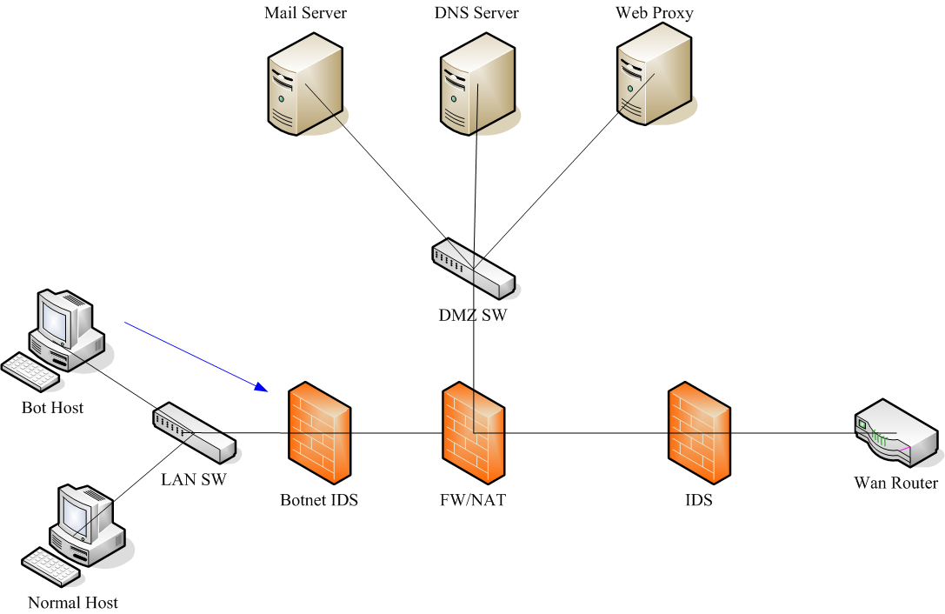
Motivation
Cloud Network Security
Firewall, Intrusion Detection/Prevention System.
Traditional architecture is not enough.
Limitations of the existing architectures:
Need to install additional software on the user’s VM.
Privacy issues
Position of the IDS is fixed.
Poor Flexibility
Amount of IDS is fixed.
Poor Scalability
Single Points of Failure.
Poor Availability
Notes:
一般而言，對於網路安全，
我們最先想到可能會是firewall ，ids ips 這些安全設備
在雲端方面也不例外，但傳統的架構並不適合直接搬到雲端環境
所以有些研究開始針對架構去做調整。
但仍然有許多限制
blah blah…..
所以我們想在這一部份做改進。

Slide 5
Contribution
Implement a system called Distributed and Autonomous Guard System (DAGS) to solve the security issues in cloud environments.
Distributed Intrusion Detection System Management
No need to install additional software on the user’s virtual machine
A Centralized Control Server
Autonomous Execution (Avoiding Single Points of Failure)
A Majority Judgment Mechanism
Notes:
所以說我們想做就是實作一個分散式且自主的安全防衛系統
我們提供一個分散式入侵偵測系的管理
而不需要安全額外的軟體在用戶端
也提供一個集中式的伺服器方便管理員使用
自主的執行 不一定要透過server
一個多數決的機制 來達到聯合防衛效果

Slide 6
Outline
Motivation
Background & Related Work
Attack Model
Design Architecture & Implementation
Analysis
Conclusion

Slide 7
Background
Cloud computing
OpenStack
Software-Defined Networking (SDN)
OpenFlow

Slide 8
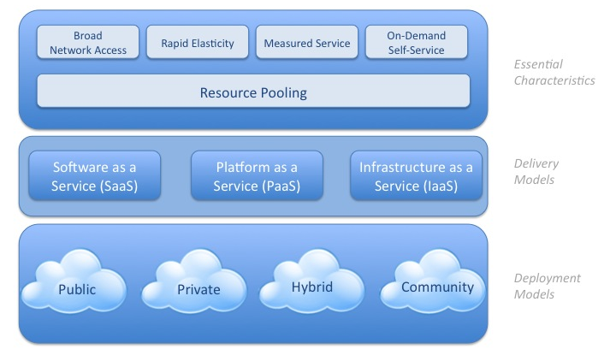
Cloud computing
A model that enables ubiquitous, convenient, on-demand network access to a shared pool of configurable computing resources that can be rapidly provisioned and released with minimal management effort or service provider interaction.
Notes:
廣泛網路接取(Broad network access)：服務是經由網路提供，且有標準機制能讓不同的客戶端平台(如智慧型手機及筆電等)都可以使用。
快速的彈性(Rapid elasticity)：計算資源不僅可以快速且有彈性地被提供或釋放，且對客戶而言，資源是取之不盡且可以恣意購買的。
可量測的服務(Measured service)：計算資源可依其所提供的服務特性被自動控管及最佳化。提供者與使用者雙方都可透明地監控資源使用情形。
自助式隨需服務(On-demand self-service)：客戶可以依其需求索取計算資源(例如伺服器或儲存空間)，且整個過程是單方面自動化的，無須與資源提供者互動。
共享資源池(Resource pooling)：服務者所提供的計算資源，例如儲存空間、網路頻寬、計算能力、虛擬機器數量等，可類比為一個大水池，能隨時依需要(重新)分配給不同平台的多個使用者。使用者不需了解資源的實體位置，只要有抽象概念即可(如資源是在哪個國家或哪個資料中心)

Slide 9
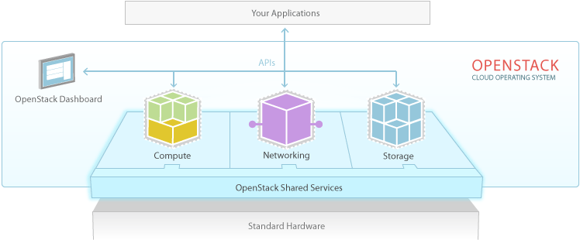
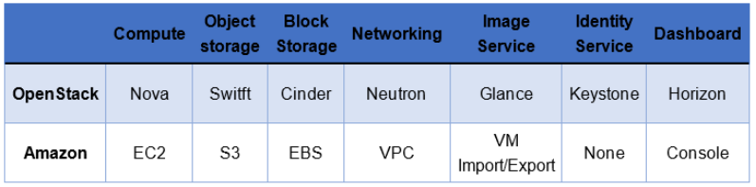
OpenStack
OpenStack is an open source software (Cloud OS )for building public, private, and hybrid clouds.
Notes:
Openstack下面的所有service都可以和amazon 一一對應
甚至連API都一樣，這會使得Porting的工作容易許多
不管是從Openstack move 到 amazon
或是從amazon move到OpenStack
都是相對容易的

Slide 10
Software-Defined Networking (SDN)
Software-defined Networking (SDN) is a new approach to designing, building and managing networks.
The architecture decouples the network control planes and forwarding planes to become directly programmable and the underlying infrastructure to be abstracted for applications and network services
Network administrators can manage network services through abstraction of lower level functionality.
Notes:
SDN基本的想法就是將傳統control plane抽離出來
這樣一來 剩下forwarding planes的機器
就會變成一個被程式化的機器

Slide 11
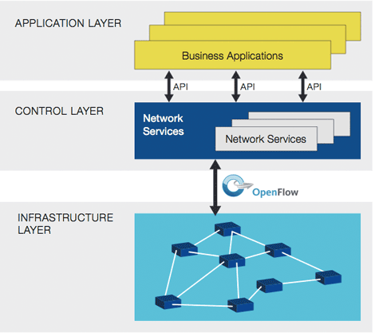
OpenFlow
OpenFlow is a communications protocol used to establish SDN solution, which gives access to the forwarding plane of a network switch over the network.
POX, NOX, RYU,
Floodlight, etc.
OpenFlow Switch
Open vSwitch
Notes:
Openflow是一個實踐SDN的communication protocol

Slide 12
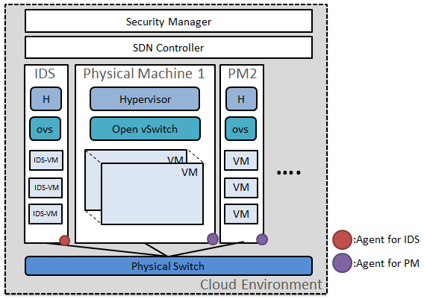
Related Work
Su-Yi Lan. Centralized Management of Cloud Security Research. Master’s thesis, National Tsing Hua University, 2013
Notes:
在這篇論文中
使用一個專門的實體機器負責入侵偵測
而在其它computing Node上需安裝代理程式，
並將網路封包集中導到IDS實體機上，
此外還有一個集中式的伺服器負責管理這些代理程式。
主要問題在於，只用一台機器做入侵偵測是不夠，performance不是很好
所有的代理程式都需和伺服器聯結很容易會有SPOF的問題

Slide 13
Outline
Motivation
Background & Related Work
Attack Model
Design Architecture & Implementation
Analysis
Conclusion

Slide 14
Attack Model
Assumptions
Internal DDoS attack within same physical server
Internal DDoS attack on different physical servers
Notes:
一些假設和兩種情境

Slide 15
Attack Model
Assumptions
An attacker could rent or infect some virtual machines in the cloud.
No VM escape problem.
A virtual machine is a ”completely isolated guest operating system installation within a normal host operating system”.
Hypervisor is secure.
It can be trusted.
Notes:
在假設的部份
第一個，攻擊者可能感染或直接租用虛擬機器
第二個，沒有VM escape的問題
第三個，Hypervisor是的安全性可以被信任

Slide 16
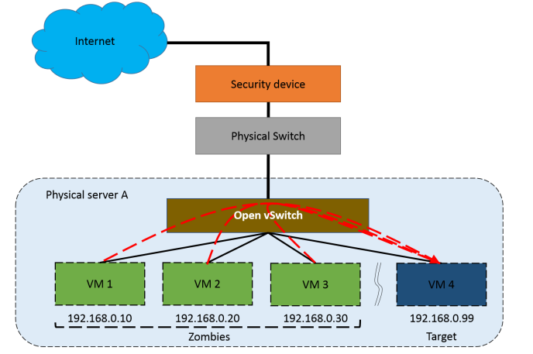
Attack Model
Internal DDoS attack within same physical server.

Slide 17
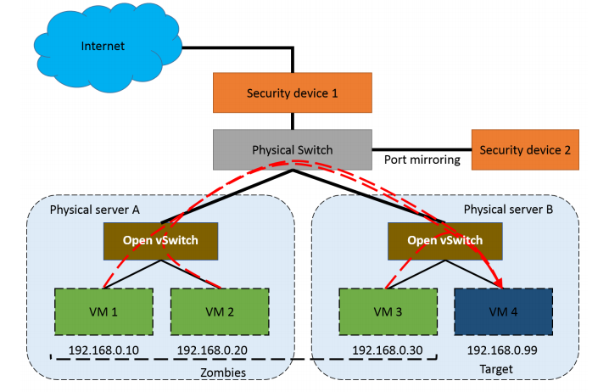
Attack Model
Internal DDoS attack on different physical servers.

Slide 18
Outline
Motivation
Background & Related Work
Attack Model
Design Architecture & Implementation
Analysis
Conclusion

Slide 19

Design architecture
GOAL:
To build a distributed and autonomous Intrusion Detection system.
It can detect and block malicious traffic in the cloud with a Software-defined networking environment.
A Centralized Control Server(portal) for the administrator to monitor and control the flow rule of virtual network interface.
Notes:
我們的GOAL是去建立一個分散式且自主的入侵偵測系統
那它有兩個功能
一個是它可以去偵測和阻擋惡意流量
另一個則提拱一個集中式的伺服器讓管理員方便管理

Slide 20
Design architecture
Distributed and Autonomous Guard System(DAGS)
Distributed Intrusion Detection Component(DIDC)
Security Agent(Autonomous Agent)
Centralized Control Server
Notes:
我們的系統簡稱為DAGS
主要分三個部份

Slide 21
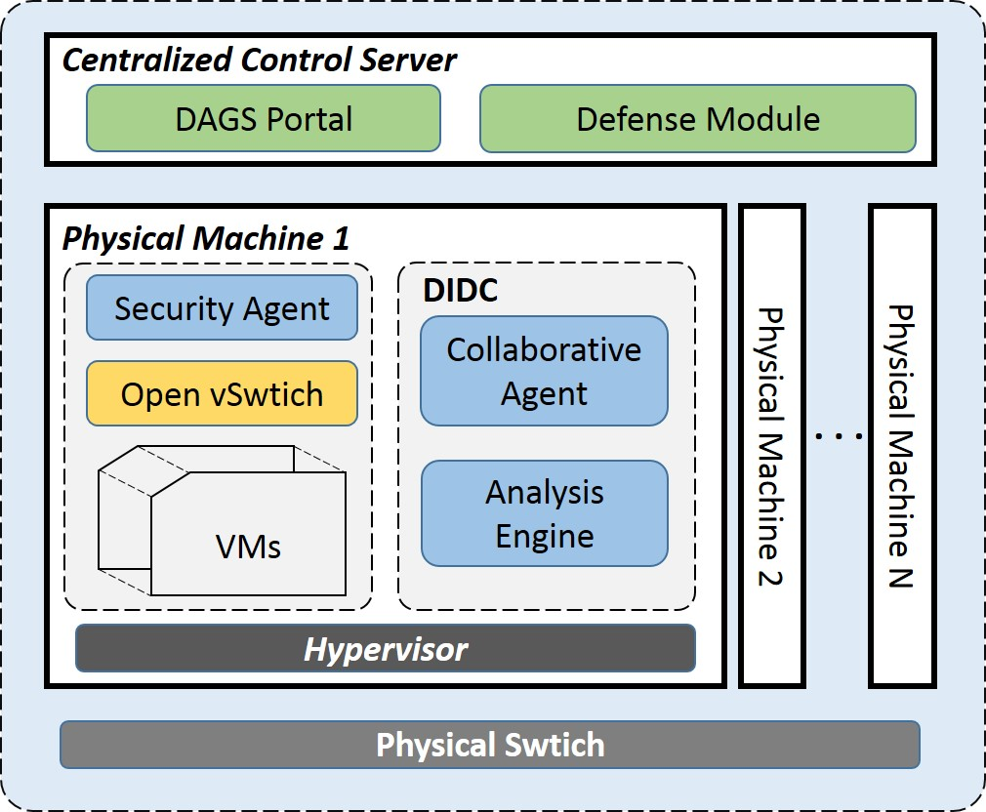
Architecture Design Overview
Notes:
一個ids管理

Slide 22
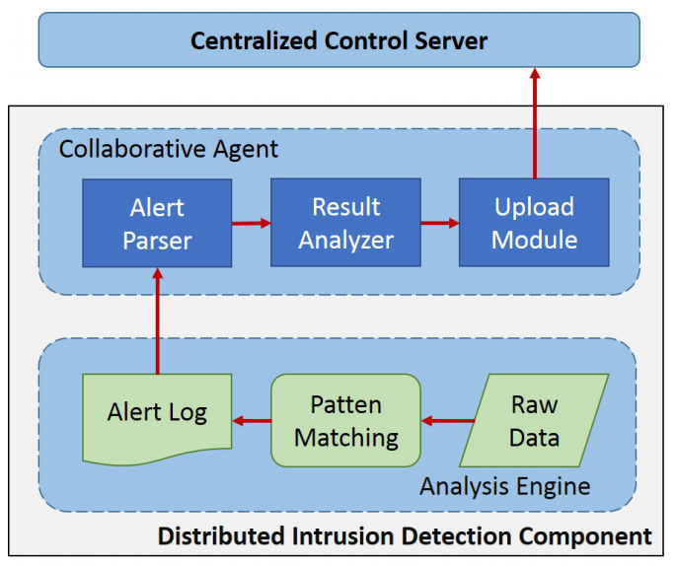

Distributed Intrusion Detection Component
Analysis Engine
Suricata - A multi-threaded IDS developed by the OISF.
Collaborative Agent
Alert Parser
Result Analyzer
Upload Module

Slide 23
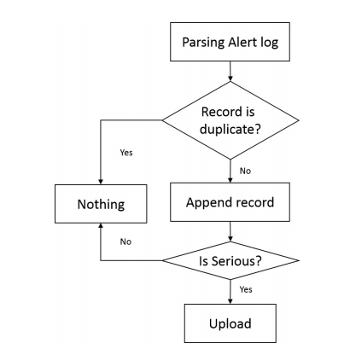
Distributed Intrusion Detection Component

Slide 24
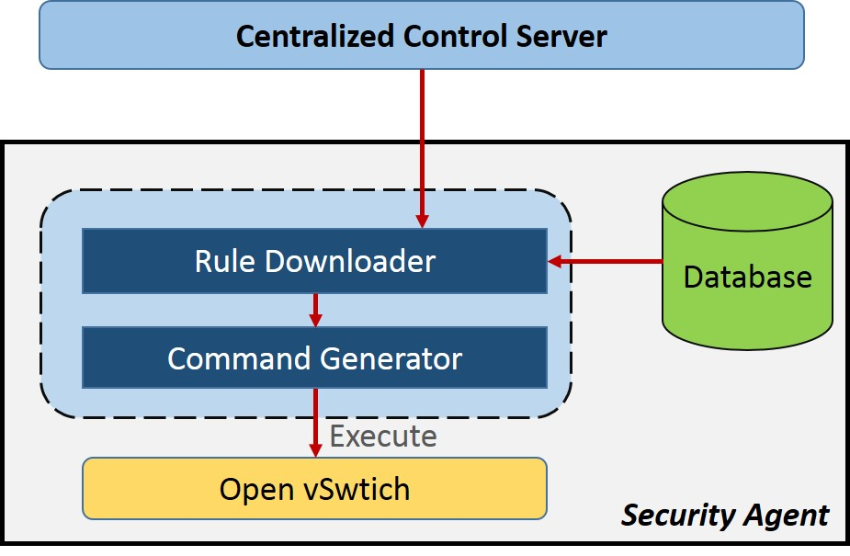
Security Agent
Security agents primarily responsible for executing the security command from the Control server.
Rule Downloader
Centralized Server
Local DB
Command Generator
OpenFlow Rule

Slide 25
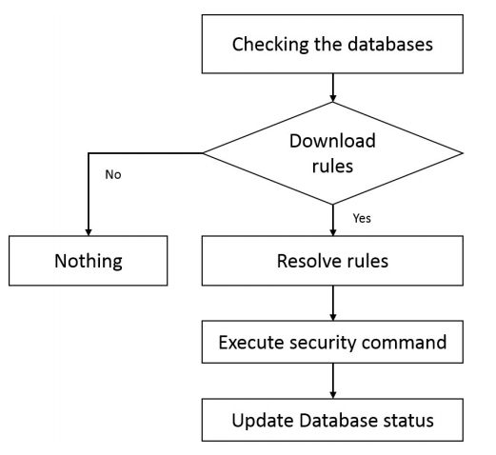
Security Agent

Slide 26
Design architecture
GOAL:
To build a distributed and autonomous Intrusion Detection system.
It can detect and block Malicious traffic in the cloud with a Software-defined networking environment.
A Centralized Control Server(portal) for the administrator to monitor and control the flow rule of virtual network interface.

Slide 27
Centralized Control Server
Databases
Account information, Alert information(IP address, port number, Protocol, direction, action, timestamp),etc.
User Interfaces
Web Portal
Applications Interfaces
SSL Chanel
Clients
Defense Module
A Majority Judgment Mechanism

Slide 28
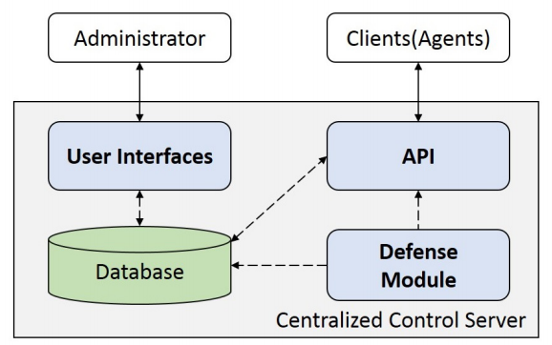
Centralized Control Server

Slide 29
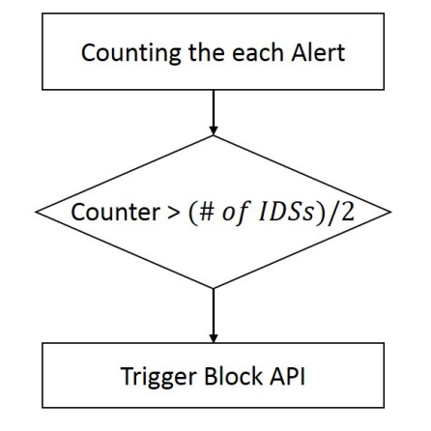
A Majority Judgment Mechanism
Notes:
只要超過二分之一的IDS偵測到一樣的alert
那我們就將它加入block list 來達到聯合防禦的效果

Slide 30

Implementation

Slide 31
Implementation
1
Building Environment
2
Distributed Intrusion Detection Component
3
Security Agent
Centralized Control Server
4

Slide 32
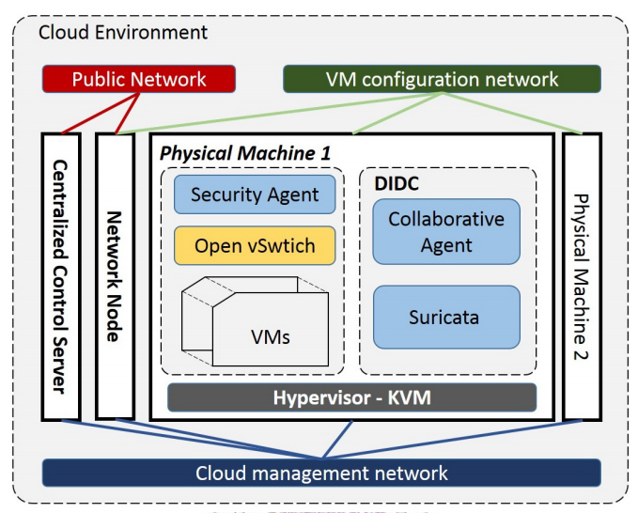
Building Environment

Slide 33
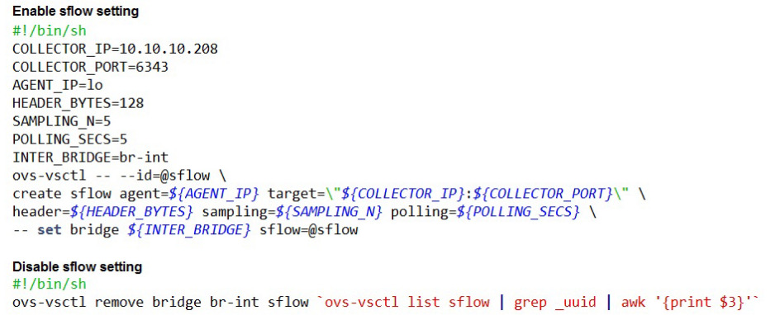
Openvswitch - sFlow
Notes:
環境建好後，我們需要的是收集封包
這個部份我們是使用一個叫 sflow的軟體，
它採用的是sampling的方式 可以降低不必要的浪費
再來就是它配置簡單可以很容易的變更目的地或收集方式

Slide 34
Distributed Intrusion Detection Component
Analysis Engine
Suricata
Oinkmaster
Collaborative Agent
Written in Python
Notes:
採用suricata做為分析引擎，
用Oinkmaster來做特徵資料庫的同步
Agent是用python寫

Slide 35
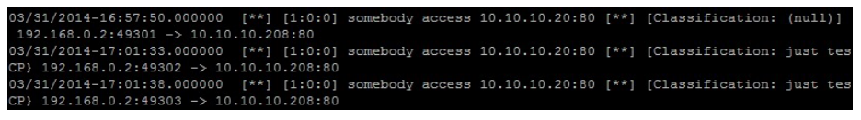
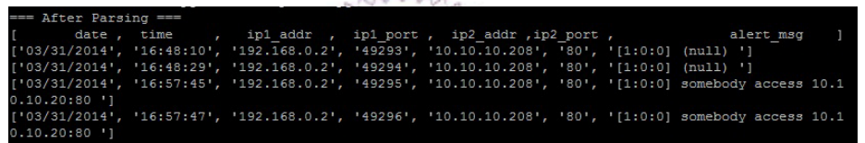
Distributed Intrusion Detection Component
IDS alert File
/var/log/suricata/fast.log
Alert parser

Slide 36
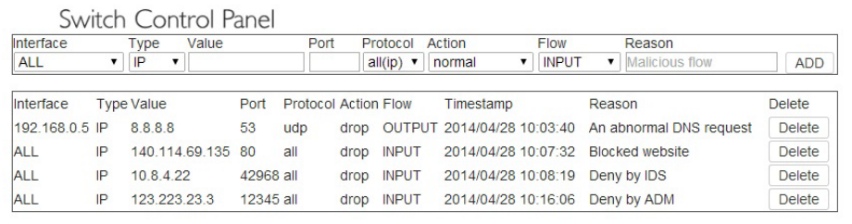
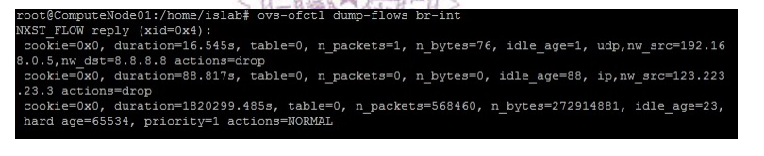
Security Agent
Rule Downloader
Command generator

Slide 37
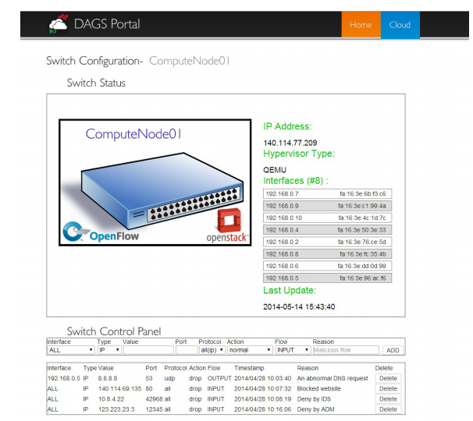
Centralized Control Server
Portal

Slide 38
Outline
Motivation
Background & Related Work
Attack Model
Design Architecture & Implementation
Analysis
Conclusion

Slide 39

Analysis
Architecture Analysis
Security Analysis
Performance Analysis

Slide 40
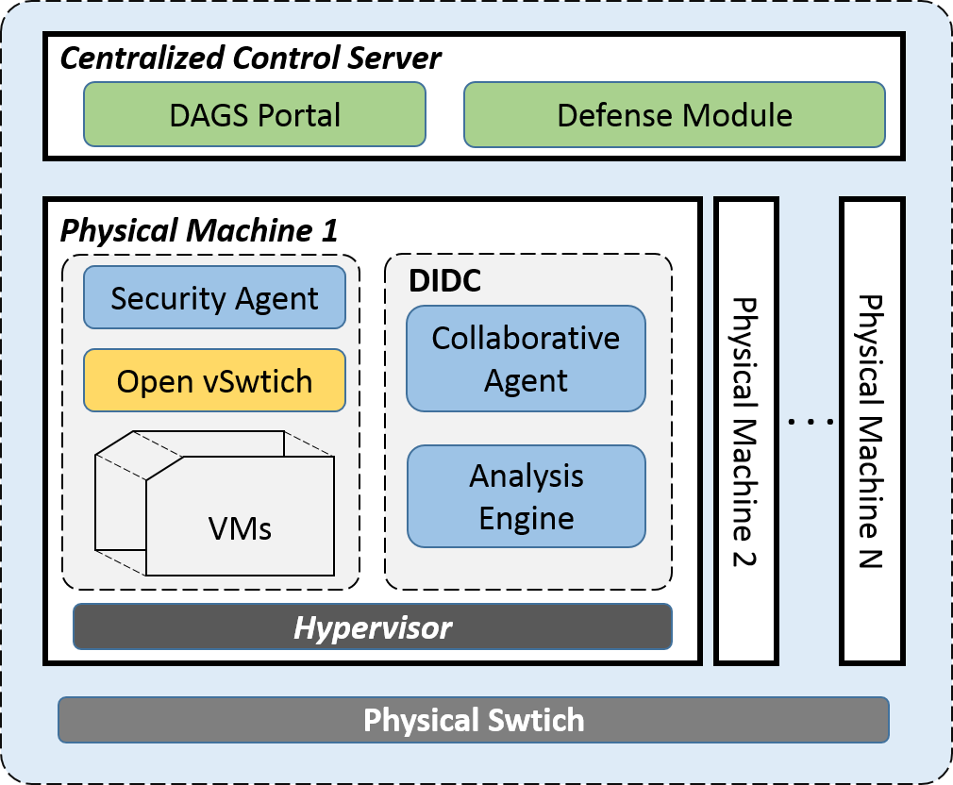
Architecture Analysis
Need to install additional software on the user’s VM?
Do not need to install additional software on the user’s vm.
Position of the IDS is fixed?
Hypervisor, Physical Machine, Virtual Machine.
Amount of IDS is fixed?
[1, # of Computing Machines)
A DIDC ↔ A Autonomous zone.
Single Points of Failure?
Security agents → local DB

Slide 41
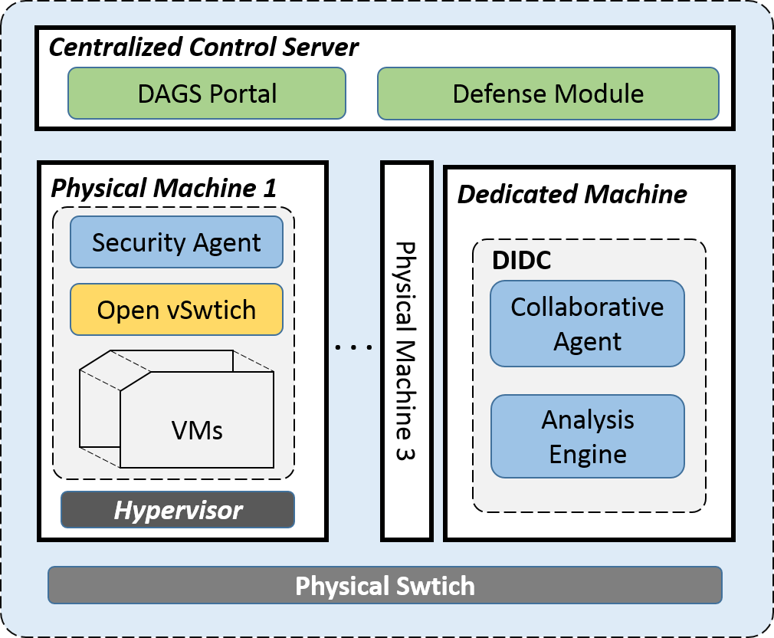
Another Model

Slide 42
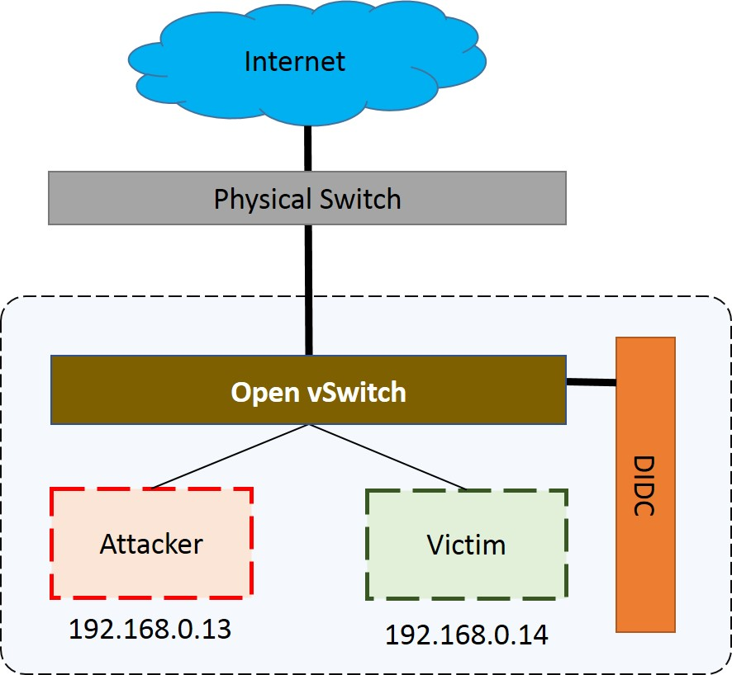
Security Analysis
Tool
DDoSim and Hping3

Slide 43
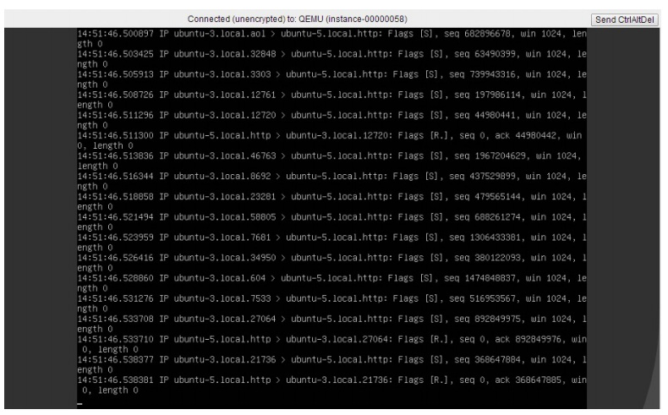
Security Analysis
Victim receives lots of TCP SYN requests
Notes:
這個截圖可以看出victim受到大量syn封包

Slide 44
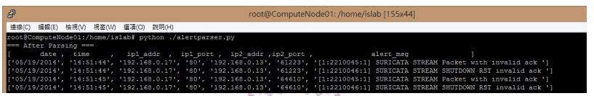
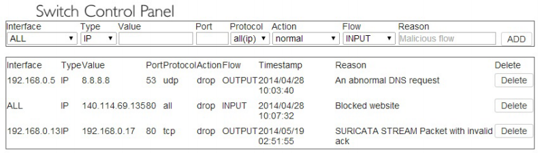
Security Analysis
Malicious flow is detected by DAGS.
Malicious flow is blocked by Server.

Slide 45
Performance Analysis
iperf
A tool that measures maximum TCP bandwidth, allows the tuning of various parameters and UDP characteristics.
Two types:
Within the same Physical machine.
Across Physical machine.

Slide 46
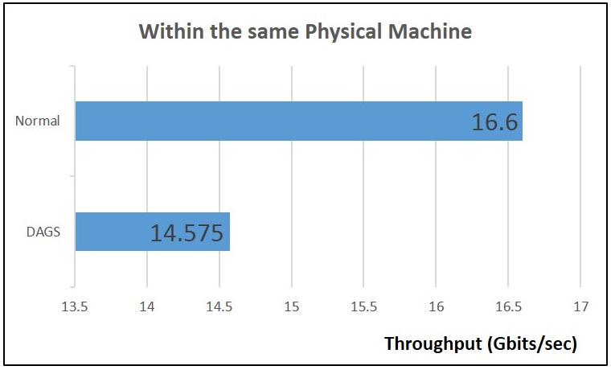
Performance Analysis

Slide 47
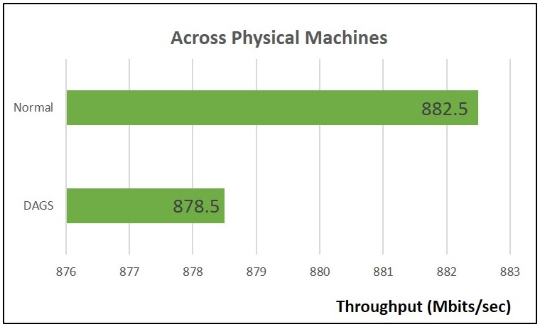
Performance Analysis

Slide 48
Outline
Motivation
Background & Related Work
Attack Model
Design Architecture & Implementation
Analysis
Conclusion

Slide 49
Conclusion
DAGS is a distributed and autonomous Intrusion Detection system that can detect and block malicious traffic automatically.
It is a simple, efficient, flexible, and scalable solution that can make the cloud more secure.

Slide 50
Future Work
Support more security problems.
Support more analysis engines (IDS).
Support more open source cloud platform.
CloudStack, OpenNebula, etc.
Add additional functionality.
For example, event report, virtual machine status monitor.

Slide 51
Thank you for listening.

Slide 52
Appendix

Slide 53
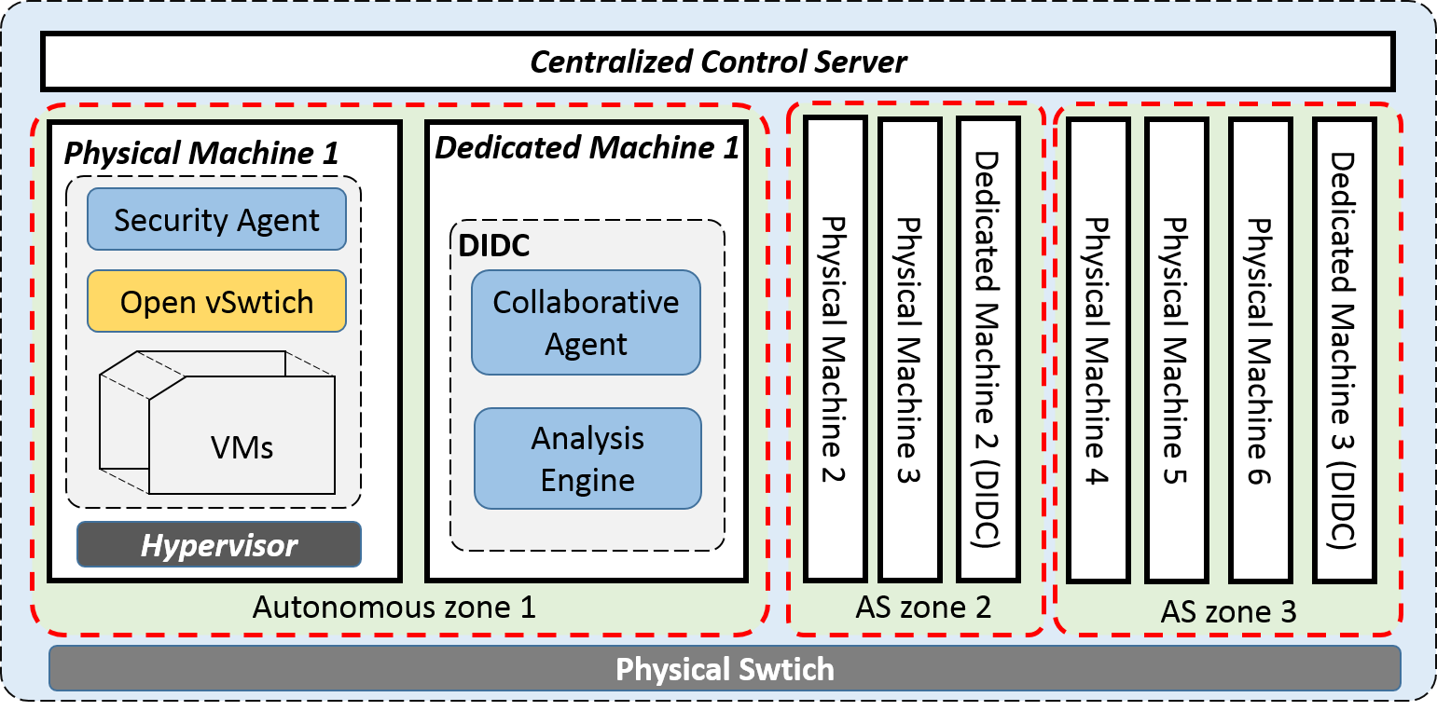
Another Model

Slide 54


OpenFlow Flow Table Abstraction
OpenFlow Firmware
Software
Layer
PC
Flow Table
Controller
MAC
src
MAC
dst
IP
Src
IP
Dst
TCP
sport
TCP
dport
Action
Hardware
Layer
*
*
*
5.6.7.8
*
*
port 1
port 1
port 2
port 3
port 4
5.6.7.8
1.2.3.4

Slide 55
OpenFlow Basics Flow Table Entries
Rule
Action
Stats
Packet + byte counters
Forward packet to port(s)
Encapsulate and forward to controller
Drop packet
Send to normal processing pipeline
Modify Fields
Switch
Port
VLAN
ID
MAC
src
MAC
dst
Eth
type
IP
Src
IP
Dst
IP
Prot
TCP
sport
TCP
dport
+ mask what fields to match
Notes:
Now I’ll describe the API that tries to meet these goals.
55

Slide 56
Examples
Switching
Switch
Port
MAC
src
MAC
dst
Eth
type
VLAN
ID
IP
Src
IP
Dst
IP
Prot
TCP
sport
TCP
dport
Action
*
*
00:1f:..
*
*
*
*
*
*
*
port6
Flow Switching
Switch
Port
MAC
src
MAC
dst
Eth
type
VLAN
ID
IP
Src
IP
Dst
IP
Prot
TCP
sport
TCP
dport
Action
port3
00:20..
00:1f..
0800
vlan1
1.2.3.4
5.6.7.8
4
17264
80
port6
Firewall
Switch
Port
MAC
src
MAC
dst
Eth
type
VLAN
ID
IP
Src
IP
Dst
IP
Prot
TCP
sport
TCP
dport
Forward
*
*
*
*
*
*
*
*
*
22
drop

Slide 57
Examples
Routing
Switch
Port
MAC
src
MAC
dst
Eth
type
VLAN
ID
IP
Src
IP
Dst
IP
Prot
TCP
sport
TCP
dport
Action
*
*
*
*
*
*
5.6.7.8
*
*
*
port6
VLAN Switching
Switch
Port
MAC
src
MAC
dst
Eth
type
VLAN
ID
IP
Src
IP
Dst
IP
Prot
TCP
sport
TCP
dport
Action
port6,
port7,
port9
*
*
00:1f..
*
vlan1
*
*
*
*
*

Slide 58
Openflow rule examples
ovs−ofctl [options] command [switch] [args...]
ovs-ofctl add-flow br-int dl_type=0x800,nw_proto=17,nw_src=192.168.0.5,nw_dst=8.8.8.8,actions=drop
dl_type=0×0800 <=> ip
dl_type=0×0806 <=> arp
dl_type=0×0800，nw_proto=1 <=> icmp
dl_type=0×0800，nw_proto=6 <=> tcp
dl_type=0×0800，nw_proto=17 <=> udp

Slide 59
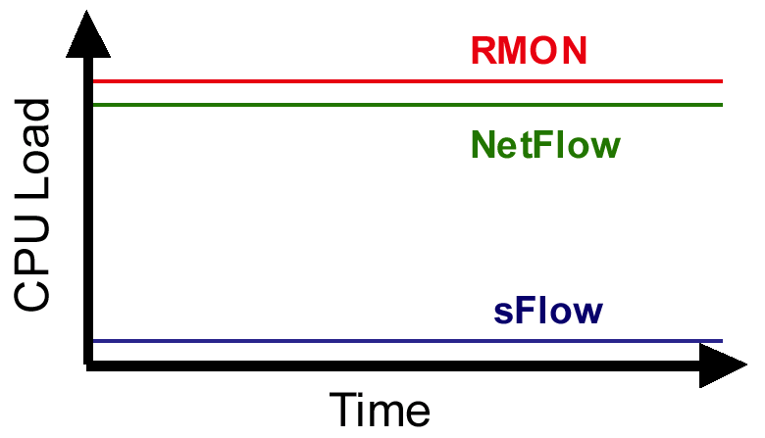
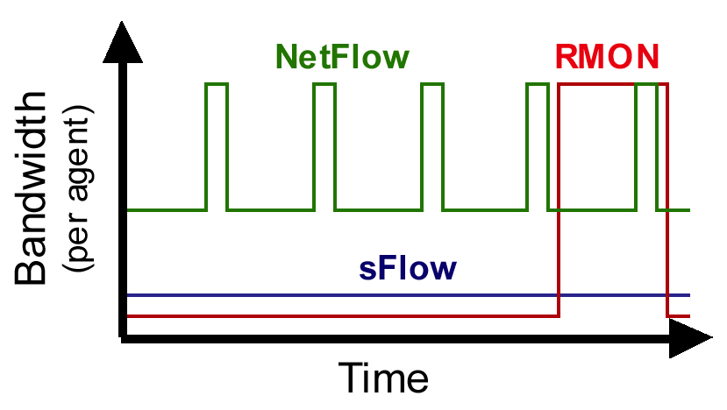
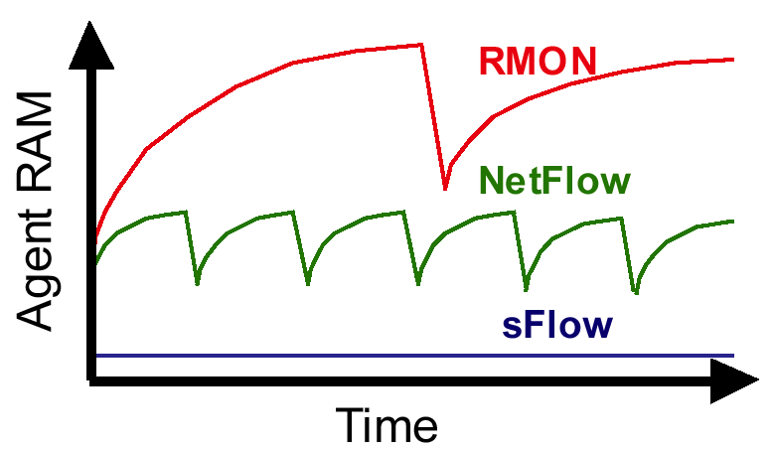
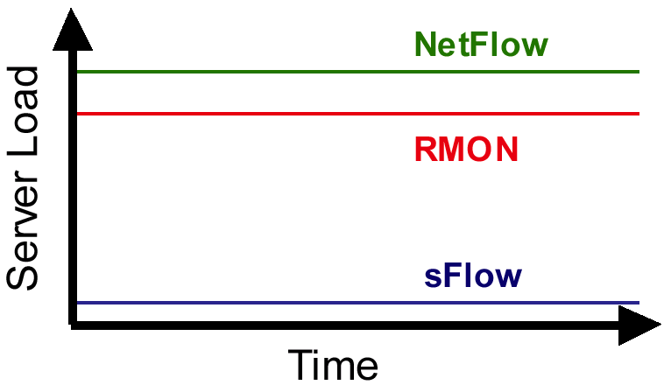
Flow comparison
Cpu Load
Bandwidth
Agent Memory

Slide 60
MRTG
NetFlow
RMON-II
XRMON
sFlow
Control real-time congestion problems
Real-time segment counters
Y
N
Y
Y
Y
Real-time top talkers
N
N
Y
Y
Y
In/out view on interface
1/2
1/2
N
N
Y
MAC address
N
N
Y
Y
Y
IPv4, ICMP, TCP, UDP
N
Y
Y
Y
Y
IPv6, IPX, DecNet4, AppleTalk, FrameRelay
N
N
Y
Y
Y
Plan for growth
In/out view on interface
1/2
1/2
N
N
Y
MAC address
N
N
Y
Y
Y
IPv4, ICMP, TCP, UDP
N
Y
Y
Y
Y
IPv6, IPX, DecNet4, AppleTalk, FrameRelay
N
N
Y
Y
Y
Optimize BGP peering and routing policies
Source/Destination/Peer AS
N
1/2
N
N
Y
Full AS Path
N
N
N
N
Y
IP-Next Hop
N
Y
N
N
Y

